Slide 1

Wireless Dynamic Charging for Electric Vehicles

Slide 2
Introduction
Electric Vehicles are the upcoming future.
The major issue with electric vehicles lies with their traditional charging techniques.
Evolution of wireless power technology will be at its peak in the coming decade making EV(s) a regular part of people’s life.
Charging EV(s) with WPT will save lot of efforts and time.

Slide 3
Objective
The main objective of our project is to design and develop a wireless power transfer system suitable for electric vehicles using resonant magnetic coupling technology.

Slide 4
Proposed System
In the proposed system aims to develop an antenna and wireless power transfer system suitable for electric vehicles (EVs).
Using resonant magnetic coupling principle, the wireless power transfer technology to the electric vehicle is designed.
When the vehicle’s power receiver’s frequency is tuned in exact with the resonance frequency of the transmitter unit below the road, the electrical power will flow from the transmitter coil inside the platform to the receiving coil inside the bottom of the electric vehicle.

Slide 5
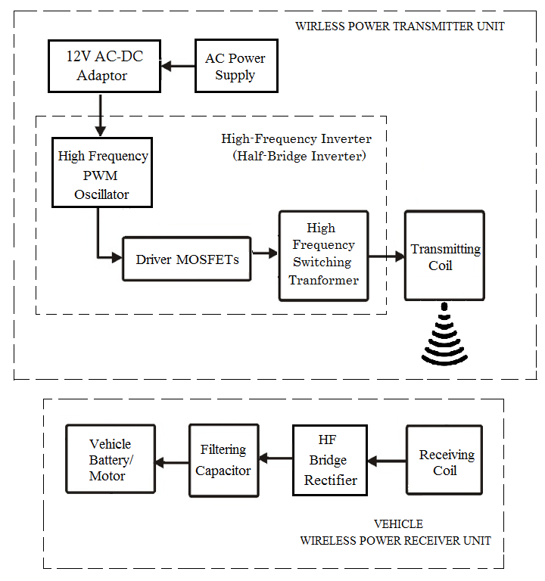
BLOCK DIAGRAM (Transmitter& Receiver)

Slide 6
Advantages
No need of line of sight
No need of power cables and batteries
Does not interfere with radio waves
Negative health implications
Highly efficient than electromagnetic induction
Less costly

Slide 7
Implementation & Achievement
South Korea implemented DWC EV(s) in its Ghumi City a 15 miles smart road for electric vehicles which is open for public use making it first Asian country to implement ‘WPT ’ technology.
Countries like China and Japan are implementing this technology as they have increased their EV market share upto 40% making it more efficient and secured technology.
Advances in dynamic wireless charging (DWC) technology have led to increased efficiency and improved alignment tolerance, making it a more viable and practical option for commercial use in electric vehicles.

Slide 8
Future Work
One of the most important factors that must be considered in designing an inductive coupling system is the target power of the system.
Because the wireless power transfer system for moving electric vehicles is a public service system that is installed in a road, the use of the resonance frequency must be permitted by the government.

